Slide 1

IOT BASED URBAN UTILITIES MANAGEMNT
PROJECT TEAM MEMBERS
21ME1A0222 | KONAKALLA LAKSHMI SHANMUKH PAVAN SAI
22ME5A0216 | SURISETTI VEERENDRA KUMAR
21ME1A0205 | BANDUCHODE KUMAR
21ME1A0208 | CH JAYA SAI KUMAR
21ME1A0203 | BALANAGU SAI KRISHNA
Mentor: R. NAVEENKUMAR
ASSISTANT PROFESSOR
Department of Electrical And Electronics Engineering

Slide 2

CONTENTS:
Abstract
Introduction & Background
Problem Statement & Objectives
Literature Survey
Existing / Traditional system
Methodology / Proposed System
Hardware & Software Requirements
Design & Implementation
Results & Observations
Advantages & Applications
Conclusion
References

Slide 3
Abstract
A smart city solution called the IoT-Based Urban Utilities Management System was created to automate and track important public utility services like water distribution, manhole condition, and street lighting. The ESP32 microcontroller, which is at the center of the system, communicates with a number of input and output modules to guarantee effective and perceptive urban utility management. In order to ensure that the street lighting system is not only turned on but also operating, it is automated with a Real-Time Clock (RTC) for time-based control and an LDR (Light Dependent Resistor) for real-time defect detection. Relay2 is also used by the system to regulate the streetlights. ultrasonic sensor is used by the manhole monitoring device to identify spills, obstructions, and abnormal water levels. A buzzer is activated for nearby notice and alerts are sent via the GSM module if a critical level is reached. The system has a smart water pump that is turned on by Relay1 to control water distribution in public areas. The ESP32 is used to monitor and control this, and it can be activated by a linked mobile application (APP) or on a schedule. Local monitoring and IoT-based control are made possible by the system's RPS (Regulated Power Supply) and LCD display, which also gives real-time feedback. This project serves as an example of an urban utility management strategy that is scalable, real-time, and economical. It is a major step toward future-ready smart city infrastructure since it decreases manual intervention, conserves energy and water, and improves public safety.

Slide 4
Introduction
This project presents an IoT-based solution for automating and monitoring essential urban utilities—street lighting, public water distribution, and manhole status detection—aimed at enhancing city infrastructure management. The system is powered by the ESP32 microcontroller and integrates sensors like LDR, ultrasonic, and RTC, along with GSM and Wi-Fi modules for real-time communication and control.
Automated streetlight operation based on RTC schedules and LDR status verification.
Smart water pump control for optimized public water usage.
Real-time manhole monitoring with alerts for overflows.
A centralized dashboard and mobile app enable remote monitoring, while alerts are delivered via SMS and buzzer alarms. The system reduces manual intervention, energy and water wastage, and ensures a safer urban environment. This scalable, cost-effective prototype moves a step closer toward smart, sustainable cities.

Slide 5
Previous Research:
Importance of the Project:
Various cities have piloted smart street lighting using motion detection and LDR sensors to save energy.
Projects on IoT-based water level monitoring have proven effective in rural water tanks and irrigation.
Some smart bin systems using ultrasonic sensors and GSM modules have been trialed in cities like Pune and Bangalore.
Research papers support the use of microcontrollers (Arduino, ESP32) for low-cost IoT implementations.
Rapid urbanization demands smarter infrastructure.
Reduces manual effort and operational costs.
Conserves critical resources like water and electricity.
Enhances cleanliness and public hygiene through smart waste monitoring.
Promotes real-time decision making via IoT connectivity.
Supports the vision of sustainable and smart cities (aligned with SDG goals)

Slide 6
Problem Statement & Objectives
In rapidly growing urban environments, the management of essential utilities such as street lighting, water distribution, and waste disposal has become increasingly complex and inefficient. Traditional systems depend heavily on manual supervision, which leads to several critical challenges: Energy wastage, Water loss, Delayed waste disposal, Increased costs and labor.
Develop an IoT-enabled smart street lighting system using LDR and motion sensors.
Implement automated water level monitoring and leakage detection using ultrasonic sensors.
Design smart waste bins to monitor fill levels and send real-time alerts.
Enable remote monitoring and control via cloud-based dashboards.
Minimize resource wastage and operational costs.
Contribute to the development of smart, sustainable urban environments.

Slide 7
Literature Survey
Various researchers have explored IoT-based approaches to improve urban utilities. Suseendran et al. designed a streetlight system using LDRs and video sensors, while Lavric et al. implemented WSN-based control for limited light units. Archibong et al. introduced solar-powered lighting with anti-vandalism monitoring. Studies by Prasad and Abdullah showed significant energy savings using motion sensors and adaptive lighting control. Sukhothai et al. employed LoRa WAN for long-range communication, and Mary et al. developed a Zigbee-based system for smart lighting control. Although these projects contributed to energy efficiency and automation, most were limited to street lighting. In contrast, our work provides a more comprehensive solution by integrating smart control of streetlights, manhole monitoring, and water distribution into a single, scalable IoT.

Slide 8
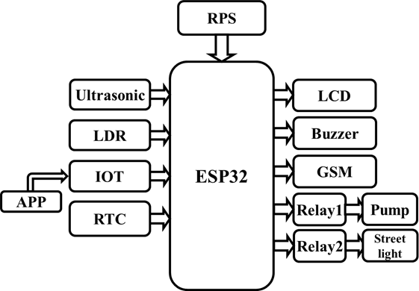
Proposed System
BLOCK DIAGRAM:
Fig 1: Block Diagram Of Iot Urban Utilities Management
An ESP32 microcontroller is employed in this project to optimize and automate municipal services, including smart streetlight management, manhole monitoring, and scheduled water supply. To ensure efficient and reliable performance, the system includes a Real-Time Clock (RTC), ultrasonic sensors, an LDR, Internet of Things connectivity, and a GSM module.

Slide 9
The proposed system is a smart IoT-based solution that integrates street lighting, water level monitoring, and waste management into a single platform. It uses sensors, microcontrollers, and wireless communication to automate and remotely manage these utilities in real time.
For streetlights, LDR and motion sensors adjust brightness based on light and movement, reducing energy consumption.
Ultrasonic sensors in water tanks detect levels and leakages, sending alerts to a cloud dashboard. Smart bins monitor waste levels and notify the system when full, improving collection efficiency.
All components are connected via Wi-Fi/GSM to a centralized monitoring system, offering a scalable, cost-effective, and resource-efficient

Slide 10
WORKING PRINCIPLE:
The system operates by using a network of sensors and microcontrollers that continuously collect data from various utility points such as streetlights, water tanks, and garbage bins. Each utility unit is embedded with specific sensors: LDR and motion sensors for street lighting, ultrasonic sensors for water level detection and waste monitoring. These sensors detect environmental conditions like light intensity, object motion, tank water levels, and bin fill status.
The collected data is processed by microcontrollers (e.g., Arduino/ESP32), which make real-time decisions based on predefined logic. For example, if a motion is detected near a streetlight at night, the light turns on or increases brightness. Similarly, if a water tank reaches a low or overflow level, or if a garbage bin is full, alerts are generated.
All data and alerts are sent via Wi-Fi or GSM modules to a cloud-based dashboard, where authorities or users can monitor and control each unit remotely. This ensures efficient resource usage, timely maintenance, and minimal human intervention, making the system both smart and sustainable.

Slide 11
Hardware & Software Requirements:
HARDWARE MODULES
SOFTWARE MODULES
NAME | RATING
ESP32 MICRO CONTROLLER | 3.3V, 80mA, 40Mhz ,448KB (ROM), 520KB (SRAM), 48
ULTRASONIC SENSOR | 5V, 15mA, 40 KHZ,
REAL TIME CLOCK (RTC) | 2.0-2.5V, 31*8 –BIT RAM
WATER DISPENSER | 0.018 KW, 0.05 HP
LIGHT DEPENDENT RESISTOR (LDR) | 200mW
NAME
Arduino IDE – Editor (Embedded C Language)
Arduino IDE – Compiler
Arduino IDE - Dump
EMBEDDED C PROGRAMMING

Slide 12
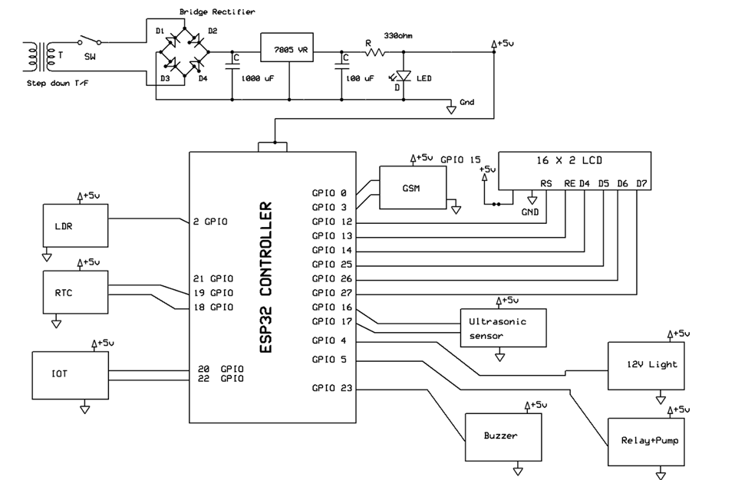
Design & Implementation
Fig 2: Design And Implementation Of Iot Urban Utilities Management

Slide 13
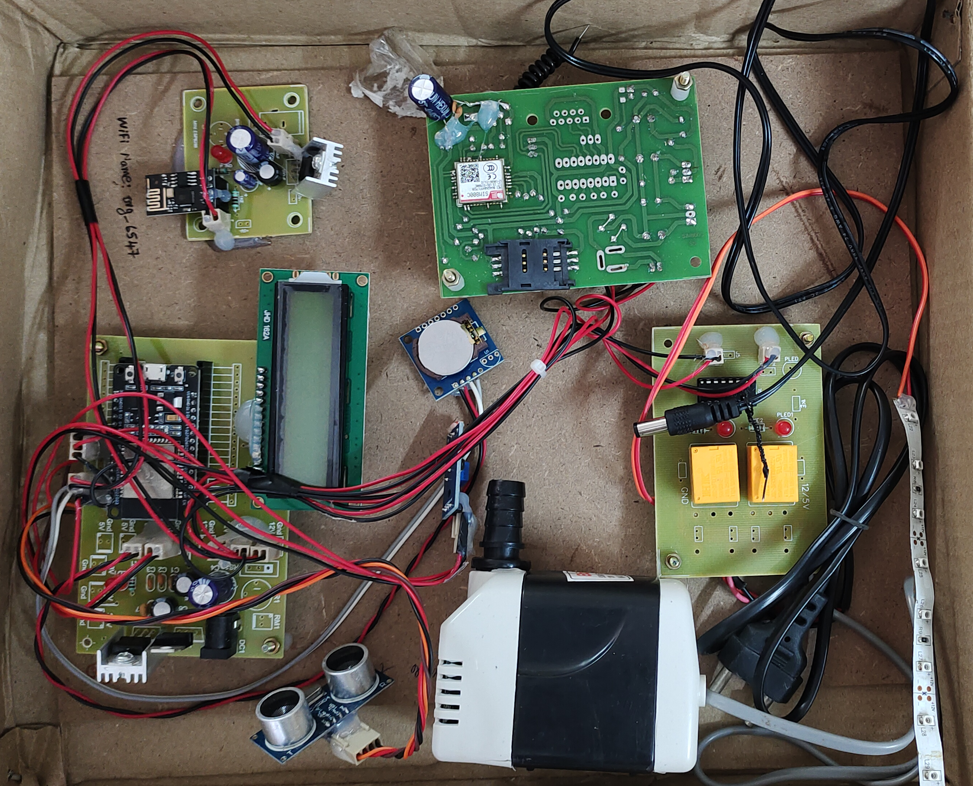
HARDWARE DESIGN
GSM MODULE
WIFI MODULE
RELAY
LCD DISPLAY
WIFI MODULE
LED STRIP
ULTRASONIC SENSOR
WATER DISPENSER
Fig 3: Hardware Design Of IOT Based Urban Utilities Management

Slide 14
Design & Implementation:
The system is designed around a modular IoT architecture, where each urban utility street lighting, water tank monitoring, and waste management operates through dedicated sensing and control units. Each module is powered by microcontrollers (Arduino or ESP32), which interface with respective sensors such as LDRs, ultrasonic sensors, IR, and motion detectors. The streetlight module adjusts brightness based on light levels and movement; the water tank module detects water levels and overflow conditions; and the waste management unit tracks garbage bin fill levels.
These modules are interconnected through wireless communication using Wi-Fi or GSM modules, enabling real-time data transmission to a central cloud dashboard. The backend dashboard is developed for remote monitoring and alert generation, displaying live utility status and system health. The entire hardware is powered via solar panels or rechargeable batteries, promoting energy efficiency and making the system suitable for both urban and semi-urban areas. The system is implemented using cost-effective components to ensure scalability and ease of deployment in real-world environments.

Slide 15
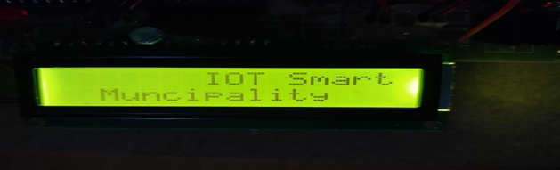
Results :
CASE 1:
Here is a paragraph about the LCD's initial setup. The LCD display is incorporated into the system to offer immediate status updates on-site, enhancing the system's transparency and providing direct feedback. Upon initialization, the LCD's primary function is to display the project's title, serving as an introductory interface for users or operators interacting with the system. This initial display confirms that the system is active and provides a clear indication of the system's purpose.

Slide 16
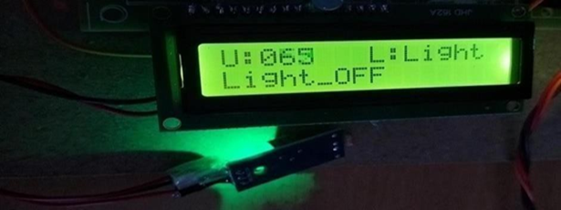
CASE 2:
LCD screen displaying "U:065 L:Light" on the top line and "Light_OFF" on the bottom line. This indicates that upon the system's startup, the LCD provides immediate feedback on the current status of the streetlight. The "Light_OFF" message suggests the initial state of the streetlight is off, while "U:065" and "L:Light" likely represent sensor readings or system parameters related to the light's operation. This initial display confirms the LCD's functionality and its role in providing real-time status information for the urban utility system.

Slide 17
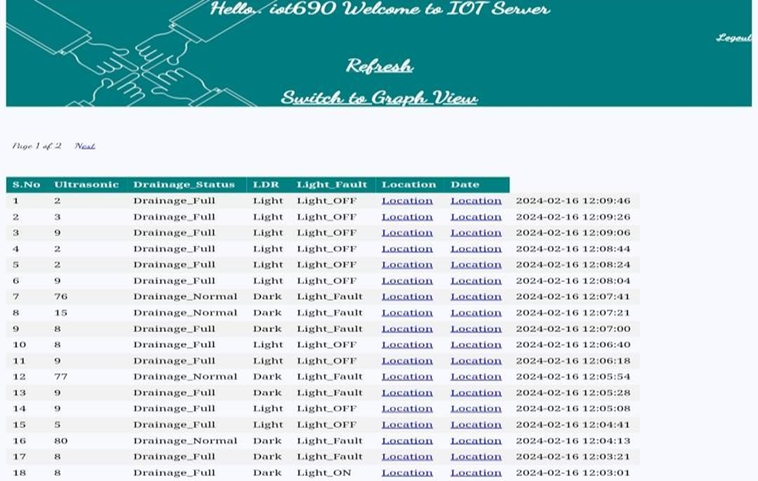
CASE 3 : RESULTS ON SERVER FOR STREET LIGHT
Here, the picture depicts the output of the system that was uploaded to the internet via an ESP8266 IOT. The locations, including the date and time, are given to the municipalities along with the drainage condition and street fault data.

Slide 18
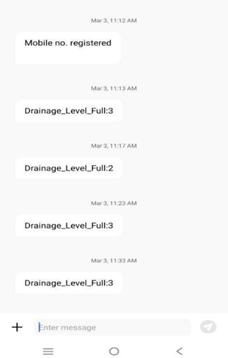
CASE 4 : WATER DISPENSER RESULTS
Illustrates the system's alert functionality for manhole monitoring, a critical component of the IoT-Based Urban Utilities Management System. The displayed mobile notifications indicate the system's capacity to deliver real-time status updates on drainage levels. As shown in the image, the system generated alerts on March 3rd at 11:13 AM, 11:23 AM, and 11:33 AM, each reporting a 'Drainage_Level_Full: 3' status. An additional alert at 11:17 AM reported 'Drainage_Level_Full: 2'.

Slide 19
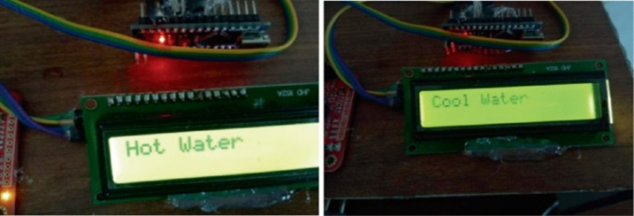
CASE 5:
LCD screen providing clear indications of the available water options. The left image shows the display indicating "Hot Water," signaling that this option is currently selected or available. Conversely, the right image presents the display showing "Cool Water," indicating the availability or selection of the chilled water option. This direct visual feedback on the LCD interface allows users to easily identify and select their desired water temperature, demonstrating a user-centric design for efficient and convenient access to the water dispensing utility.

Slide 20
Advantages & Applications:
The proposed system offers several advantages such as automation, energy efficiency, cost-effectiveness, and remote monitoring. By utilizing real-time data from sensors, it reduces manual labor, ensures faster response to issues, and enhances resource utilization. The system’s modular design allows easy integration and expansion, making it suitable for diverse urban needs.
In terms of applications, it can be deployed in smart cities, municipalities, residential societies, educational institutions, and industrial zones for managing street lighting, water tanks, and waste collection. Its ability to provide live data analytics and generate alerts makes it ideal for developing sustainable and intelligent infrastructure systems.

Slide 21
Conclusion:
This project successfully demonstrates an Internet of Things (IoT)-based municipal automation system implemented using the ESP32 microcontroller to enhance streetlight control, manhole checking, and water pump operation. The solution ensures real-time monitoring, automatic operations, and timely alerts by integrating IoT connectivity, ultrasonic sensors, an RTC module, and a GSM alert system. This significantly minimizes the intervention of human resources. By stopping manhole overflows, minimizing water wastage, and improving streetlight efficacy, the system improves resource use, urban livability, and public safety.

Slide 22
References:
[1] Kumar, Manish, Ravinder Kumar, and Ritula Thakur. "Zigbee Based Smart Street Light
Control System Using Lab VIEW." Int. Journal of Innovative Research in Science, Engineering
and Technology 5.4 (2016).
[2] Abhishek, M., K. Chetan, and K. Arun Kumar. "Design and implementation of traffic
flowbased street light control system with effective utilization of solar energy." Int. J. Sci. Eng.
Adv. Technol 3.9 (2015): 195-499.
[3] Mohamed, Samir A. Elsagheer. "Smart street lighting control and monitoring system for
electrical power saving by using VANET." Int'l J. of Communications, Network and System
Sciences 6.08 (2013): 351.
[4] Amin, Chaitanya, Paridhi Holani AshutoshNerkar, and Rahul Kaul. "GSM based
autonomous street illumination system for efficient power management." International Journal
of Engineering Trends and Technology 4.1 (2013): 54-60.
[5] K.Y.Rajput, GargeyeeKhatav, Monica Pujari and Priyanka Yadav” Intelligent Street
Lighting System Using GSM” International Journal of Engineering Science Invention Volume
2 Issue 3 , March, 2013.
[6] J.Arthi, W.Lydiapreethi, B. Gunasundari,” IOT BASED SMART LED STREET
LIGHTING SYSTEM” IJRTI | Volume 2, Issue 4 | ISSN: 2456-3315.

Slide 23


